Slide 1


Sequence Modelling using Deep Learning for Solar Irradiance Forecasting on Remote Sensing Data
By IT087-Tanay Pandya
External Guide:
Sri. Ujjwal Kumar Gupta
SCI/ENGR-SD,EPSA-VRG-CGDD
Space Applications Centre (ISRO),
Ahmedabad
Internal Guide:
Dr. Vipul Dabhi,
Head, Dept of IT,
FOT, Dharmsinh Desai University

Slide 2
Objectives:
The aims of this project were to:
(i) Develop a new convolutional long short-term memory (ConvLSTM) model for half-hour ahead solar insolation forecasting using INSAT-3D satellite images.
(ii) Develop improved model implementing spatial and temporal Attention mechanisms. The novelty of this study is the newly designed ConvLSTM-Attention model that uses weights given by the attention layer to capture dependencies of particular time-steps accordingly, further improving the model’s performance when there is cloudy weather.

Slide 3
Workdone:
Data from INSAT3D was collected. Data Preparation involved scaling, cutting, normalizing and organizing of images. Furthermore, shifted frames were created to fit the input shape of the model with proper sequence of images that are time-bounded. Finally, they were split into training and validation sets.
Model Creation: Two Separate Deep Learning Models were created in this course, one was the Base ConvLSTM model, and the other being the Self-Attention + ConvLSTM model.
Testing: These models were tested on new dataset and the error metrics like Mean Squared Error(MSE), normalized Root Mean Squared Error (nRMSE) and Structural Similarity Index Measure (SSIM) were calculated and analysed.

Slide 4
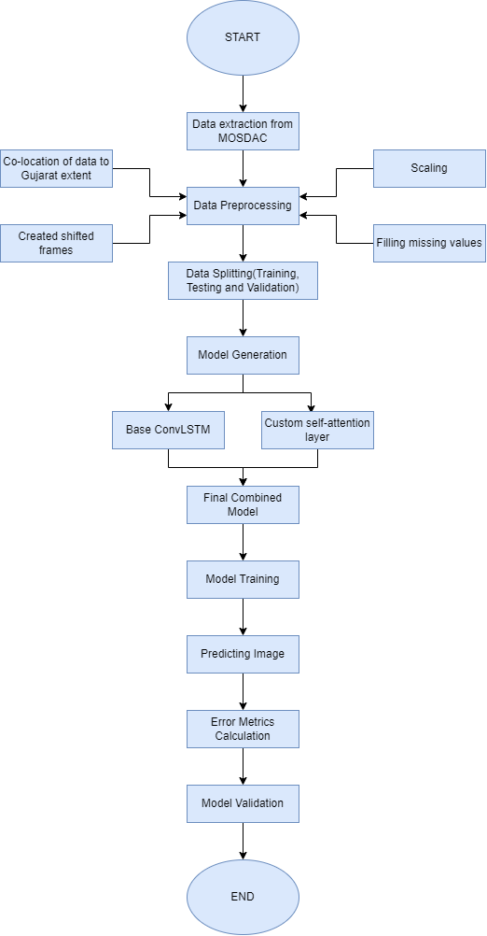
WorkFlow:

Slide 5
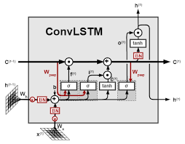
BASE ConvLSTM Model
ConvLSTM was used to create the basic model which uses convolutional structures in both input-to-state and state-to-state transitions for spatio-temporal prediction.
ConvLSTM is a neural network architecture that combines CNN and LSTM models, and processes spatiotemporal data, such as video and volumetric data.
It consists of convolutional layers that extract features and LSTM cells that capture temporal dependencies.
The model had an 5D input shape of (#Samples, FrameLength, Rows, Cols, Channels) and 3D output shape of (Rows, Cols, Channels)

Slide 6
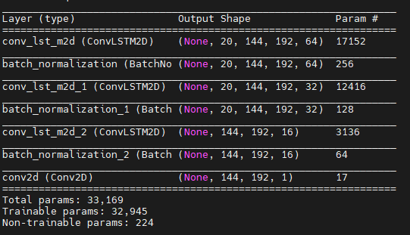
The Base Model was prepared with 3 layers of ConvLSTM2D followed by BatchNormalization/DropoutLayer, and a Conv2D layer.
Batch normalization layer is used after ConvLSTM layer to normalize the activations of the ConvLSTM output. This helps to prevent overfitting and improve the generalization performance of the model.

Slide 7
Self-Attention layer
The self Attention layer computes a set of weights that indicate the importance of each input element in relation to others. This mechanism will allow the model to attend selectively to different parts of the input, improving the quality of the predictions.
The attention layer is defined with 2 convolutional layers followed by BatchNormailzation to convert the input feature maps into attention vectors. Dot product is computed between the attention_inputs to get the attended matrix, which is flatten to get the context vector. The context vector is then normalized by ‘sigmoid’ activation function to get the attention weights. Finally, the weights are multiplied to the inputs to get the output.
This attention mechanism is applied onto the base model and the outputs are concatenated to get the combined model output.

Slide 8
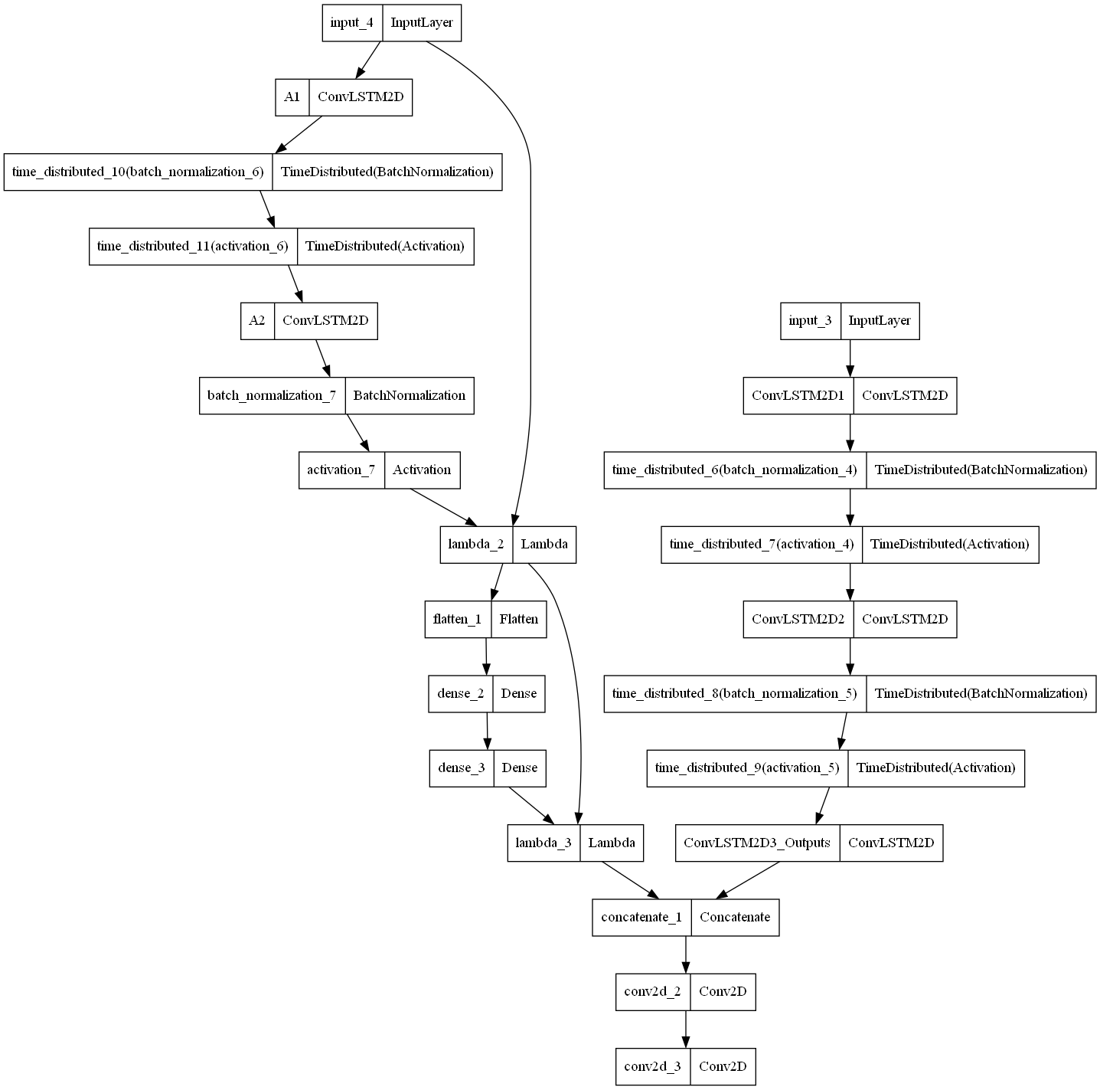
Model Diagram:
Attention layer
ConvLSTM

Slide 9
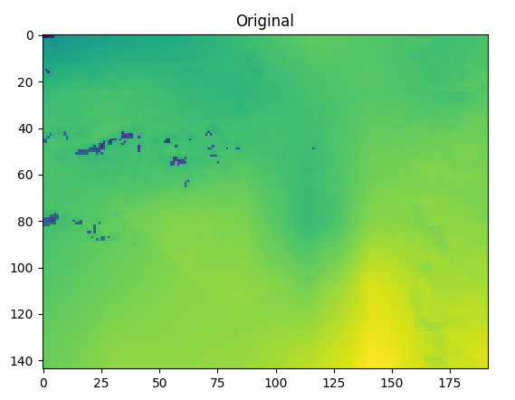
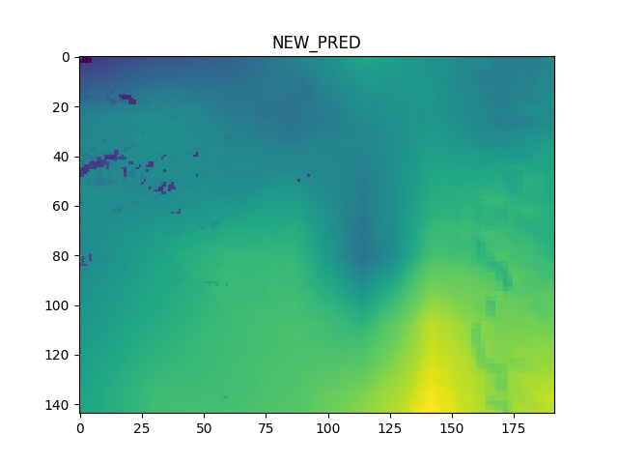
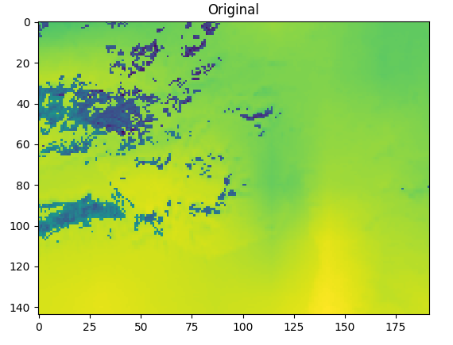
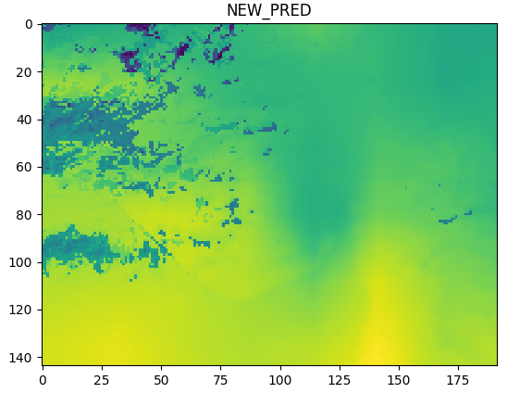
Results:
Predicted Images(Attention Model):
Expected Image:

Slide 10
Results-
The results show that the proposed Self-Attention ConvLSTM model achieved better performance compared to the baseline model. It had a validation loss of 0.89x10^-3 and nRMSE of 7.97 for January month.
The major difference could be seen in monsoon months i.e. in June, July, August and September. In these months the Attention model (nRMSE of 37.3) performed significantly better than the base model (nRMSE of 49).
These results demonstrate that the proposed model can accurately predict solar insolation with better results specifically in monsoon months where there is increase in cloud cover, generating randomness. Hence, the impact of Attention mechanism could be seen clearly. During the rest of the year, the model had similar results to the model currently in use.
When the Original and Predicted images were compared to finds similarity using SSIM , it was found that the predicted images were 92-94% similar.

Slide 11
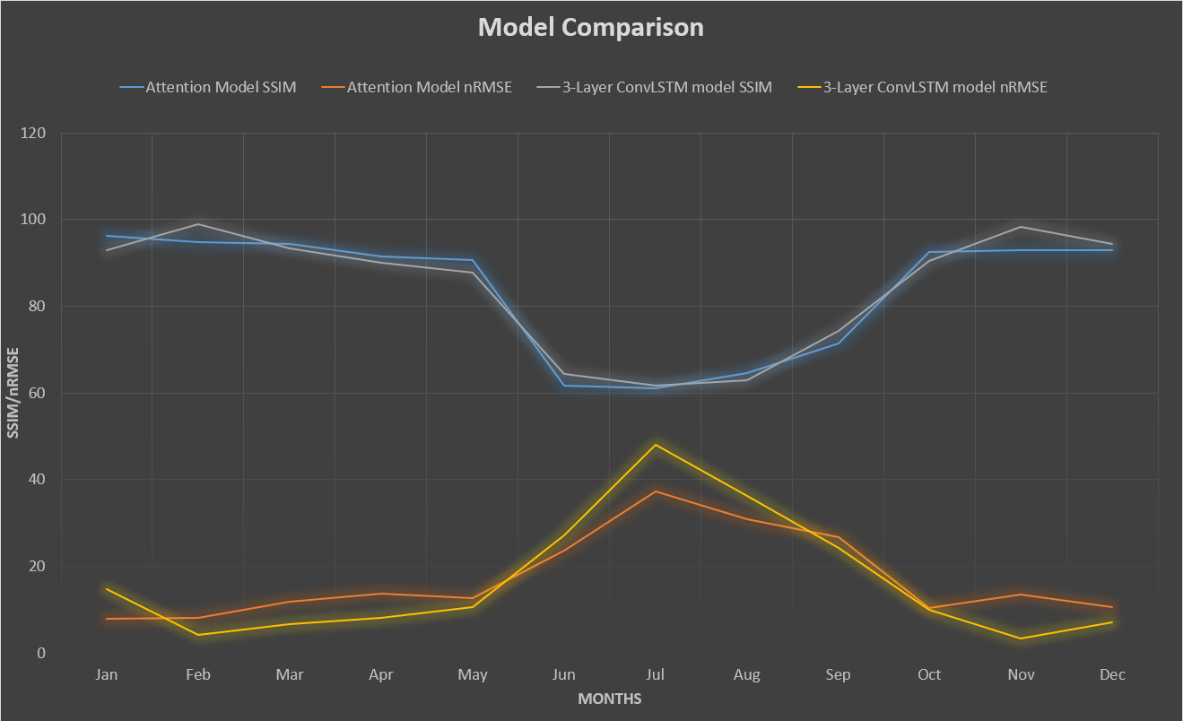
Results-

Slide 12
Challenges Encountered:
Following are some of the problems faced during the course of this project:
Missing Data: The Satellite Data of INSAT3D INS product had a lot of missing data at various time steps. Hence, these data needed to be filling using averages of previous or corresponding data images.
Restructuring of Data: ConvLSTM inputs data in a 5-dimensional format, hence it was required to reshape and create shifted frames so that model interprets the data images correctly without ignoring the temporal features.
Implementing Attention over ConvLSTM: One of the major tasks was applying the attention layer which has both spatial and temporal aspects over the ConvLSTM outputs. The Input shapes needed to be matched so that attention is applied and we get attention weights of each image separately.

Slide 13
Future work:
The proposed model has the potential to improve the performance of solar energy forecasting systems and advance our understanding of the complex interactions between the Earth's atmosphere and solar radiation.
the area of solar insolation prediction using ConvLSTM and self-attention models has great potential for future work. Some of the possibilities include Exploring different architectures, Incorporating other data sources, Adapting the model to different regions and Developing real-time prediction systems.

Slide 14
Summary:
Type of Models | Deep Learning Sequence model and Attention model
Number of models created | 3 unique models x12 (months)
Number of Datasets Prepared | 2
Size of Datasets Apprx. | 60GB
Lines of Code per model | 300
Total Lines of Code Written: | 1000
Various Tools implemented: | RNN, LSTM, GRU, ConvLSTM, Attention, Transformers, etc.

Slide 15
Conclusion
In conclusion, the project demonstrated that the ConvLSTM model when applied with self-attention techniques improved it’s performance particularly in monsoon months with high cloud cover, where the base model underperformed.

Slide 16
Thank You!

